Slide 1
CREATING DATABASES
Start the way we mean to go on…

Slide 2

So You’re Ready to Create Your First Database
But, what is a database? A collection of data? Yes, however lets look deeper
Each piece of our data is on a single sheet of A4 paper – to prevent data loss we need a storage system
We invest in a filing cabinet. Each drawer is a group of data and tabs inside are a section

Slide 3
What is a Database?
Our database is similar to our filing cabinet, it organises our data
A database is a collection of tables
Each table is sorted into columns
Each column constructs a row
Column

Slide 4
Designing Databases
There are two stages to planning a database:
Take our User Requirements (from our first section) and turn them into a Logical Model
Expand on the conceptual model to create a Physical Model of tables & columns
From this we can implement our database and load our data

Slide 5
Creating a Little Bit of Logic
Let’s look at a basic ordering system
Each process as a minimum requires…
Customer
Product
Order
Order Lines
Each of these is what we call an Entity
Customer
Product
Order
OrderLines

Slide 6
Entity Matchmaking
Now we have our Entities, but they’re a little shy. We need to help them relate to each other. What do we know about a customer order?
Customers have many Orders
Orders have many Order Lines
Order Lines have one Product
Order has one Customer
Let’s see how this changes our model
Customer
Order
OrderLines
Product

Slide 7
Relational Database Models
This is what we call a Relational Database Model because we can see how all our entities relate to each other
Single entity relationships are denoted with a single line
Multiple entity relationships are denoted with ‘crows feet’
Customer
Order
OrderLines
Product

Slide 8

CHALLENGE TIME!
Using your apps requirements build a list of Entities
Use these entities to for Relationships and create a Logical Model
Share your Entities and logical models on our Discord Channel

Slide 9
Delivery App Entities
Looking back at our requirements we can see that our Entities should be:
Customers
Drivers
Deliveries
Items
Retailers
Orders
Customers
Drivers
Deliveries
Items
Retailers
Orders

Slide 10
Delivery App Relationships
Now we have our entities we can start building relations:
Customers have many Orders
Drivers have many Deliveries
Deliveries have one Order
Deliveries have many Items
Retailers have many customers
Orders have many deliveries
Customers have one Retailer
Retailers
Customers
Orders
Deliveries
Drivers
Items

Slide 11

Let’s Get Physical
Why do we need to know how our entities relate? So we can see how our database will Function day-to-day when we create our physical model
However our relations aren’t the only consideration – it’s decision time!
Entities gave us Tables – now it’s Properties gives us Columns

Slide 12

Data Considerations & Inputs
When we design our database there are decisions we must make – these are led by our Considerations & Inputs:
Normalised Relations
Estimated Volumes
Property Definitions
Administration Needs
Data Integrity
Database Management Tech

Slide 13
Data Decisions
All of our considerations & inputs should lead us to more natural decisions on how we store our data, such as:
Property Data Types
Physical Record Volumes
Record Organisations
Indexes & Architectures
Query Optimisation
Let’s look at these a bit more in depth

Slide 14
Properties & Data Types
All Entities require Properties – these are what divide & organise our data inside our entity, however each section needs the right container - these are our Data Types
To define our data types we need to decide how we want our data to be outputted – for this let’s set some properties for our Order entity Properties are what later become our Order Columns in our database
Order
CustomerID | UniqueIdentifier
Date | DateTime
Status | Boolean
Tax | Float
Total | Number
Payment | Varchar

Slide 15
Physical Record Volumes
We also need to know how big our container needs to be - these are Volumes
Some of our data types will do this automatically (i.e. Booleans) but some will need our help
These are mostly Varchars & Floats, whose volume act as a max value to protect the overall size of the database & the data integrity
Order
CustomerID | UniqueIdentifier | -
Date | DateTime | -
Status | Boolean | -
Tax | Float | 2
Total | Number | -
Payment | Varchar | 25

Slide 16
Record Organisation
We need to find a customers order, first we search their Customer ID
Oh no! Since opening, our customer placed 10 orders with us, so what Date did they place the order?
Doh! Our customer placed 2 orders that day, so how much was the Total of their order?

Slide 17
Record Organisation
Finally! We find our customers order, but we had to ask three questions
Can we find the same order by asking only one question?
We can ask the customer for a unique Order ID number
Each question we ask our database uses a resource, the less questions we can ask the better our database will perform
Order
OrderID | UniqueIdentifier | -
CustomerID | UniqueIdentifier | -
Date | DateTime | -
Status | Boolean | -
Tax | Float | 2
Total | Number | -
Payment | Varchar | 25

Slide 18
Indexes & Architectures - Primary Keys
Now we have our Order ID property we can make even more use of it by making it a Primary Key – this one of three types of Index
Primary Keys indicate that the field is unique and is the identifier for the entity and as such will assign a unique value to the record for us giving it an indexable value
Order
OrderID | UniqueIdentifier | -
CustomerID | UniqueIdentifier | -
Date | DateTime | -
Status | Boolean | -
Tax | Float | 2
Total | Number | -
Payment | Varchar | 25

Slide 19
Indexes & Architectures – Foreign Keys
Sometimes we may need to reference another index in our search results – a Foreign Keys allow us to inject a record from another entity into our existing record
The foreign key in our order entity is the Customer ID property – by using just the Customers ID no. we can access their data such as address, name etc.
Order
OrderID | UniqueIdentifier | -
CustomerID | UniqueIdentifier | -
Date | DateTime | -
Status | Boolean | -
Tax | Float | 2
Total | Number | -
Payment | Varchar | 25

Slide 20
Query Optimisation
By putting all these measures in place we have already optimised our queries
We created properties so we don’t have to access the whole record
We set volumes to limit the size of the data we search
We created an ID field to limit properties to search over
We indexed the ID fields to stop us duplicating data across entities
All this helps to shave precious time off returning a result, which reduces the load time of our app
Order
OrderID | UniqueIdentifier | -
CustomerID | UniqueIdentifier | -
Date | DateTime | -
Status | Boolean | -
Tax | Float | 2
Total | Number | -
Payment | Varchar | 25

Slide 21
CHALLENGE TIME!
Using your Logical Model create a Physical Model that includes the following:
Properties
Volumes
Unique IDs
Indexes
Bare in mind that our Order Entity was one of four and to build a complete model we need to put all the following in place for each and every entity
Share your Physical Models on our Discord Channel
For bonus points discuss some of the decisions you made and why you made them

Slide 22
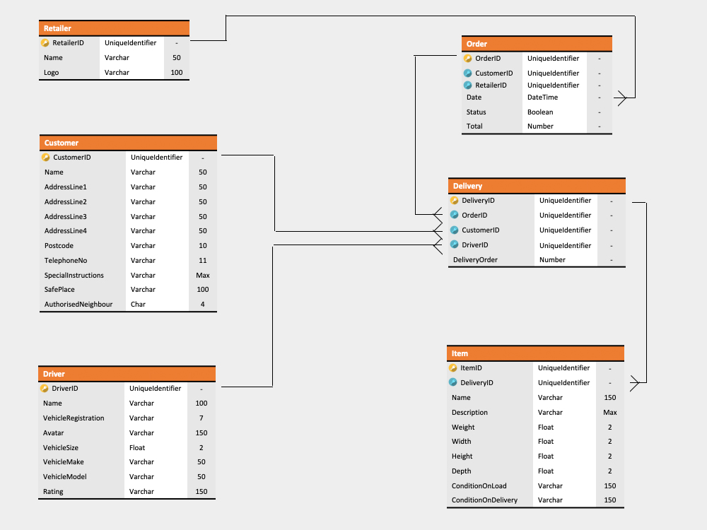
Delivery App Physical Model

